Slide 1


FULL STACK WEB DEVELOPMENT WITH DJANGO
Lecture 22

Slide 2

Today’s Agenda
Developing Our Django App
Using Django’s Model Form Library

Slide 3
Introduction To ModelForm
The contact form is a common, but very simple use of a website form.
Another common use for forms is to collect information from the user and save that information in the database.
Examples include entering your personal information for a membership application or saving details of a product like Book

Slide 4
Introduction To Model Form
Using forms for collecting and saving data from users is so common that Django has a special form class to make creating forms from Django models much easier – model forms.
With model forms, we create a Django model and then create a form that inherits from Django’s ModelForm class.

Slide 5
Benefits Of Model Form
A ModelForm is useful when we want to create forms from Database fields.
We can add our own validation checkers on the Database Model fields.
We can include and exclude fields from the Model as per our choice.
Easy to quickly save Form data to the database.

Slide 6
How To Create Model Form ?
Building a form from a model is really easy.
We just need to do 4 things:
Define the Model for which the Model Form has to be designed
Extend the django.forms.ModelForm class
Specify the Model (that we want to built the form from) in the Meta class
Specify the fields to include. before building our model form.

Slide 7
Example
Our Model class
class Author(models.Model):
name = models.CharField(max_length=40)
dob = models.DateField()
Our ModelForm class
from django.forms import ModelForm
class AuthorForm(ModelForm):
class Meta:
model = Author
fields = '__all__'

Slide 8
Explanation
The form's model Meta attribute specifies the Model to use to build the form and the fields attribute specifies the fields that need to be included in the form.
The fields attribute takes a list (or a tuple) of model field names.
The special string '__all__' specifies that all the fields in the model needs to be included

Slide 9
Field Types
The generated Form class will have a form field for every model field specified, in the order specified in the fields attribute.
Each model field has a corresponding default form field.
For example, a CharField on a model is represented as a CharField on a form.

Slide 10
Field Types
Model Fields | Form Fields
CharField | CharField
TextField | CharField with widget=forms.Textarea
IntegerField | IntegerField
DateField | DateField
FloatField | FloatField
EmailField | EmailField
BooleanField | BooleanField

Slide 11
Saving Model Forms Into Database
Model forms provide a close binding of forms to the models and allow us to save the data into model directly with the save() method.
In our example of AuthorForm model form, once the data is validated with the is_valid() method we can use the form.save() method to create a model instance (saved to database).
The method will return a model instance if it is successful.

Slide 12
Saving Model Forms Into Database
Using the model form AuthorForm to create a model instance of Author, our view would look like this:
from .forms import AuthorForm
def createAuthorView(response):
if response.method == 'POST':
form = AuthorForm(response.POST)
if form.is_valid():
author = form.save()
return render(response, 'posts/message.html', {'message': 'Successful'})
else:
return render(response, 'posts/create.html', {'form': form})
else:
form = AuthorForm()
return render(response, 'post/create.html', {'form': form})

Slide 13
An Example
To understand this entire process let us create an app for inserting record in the Book Model using Model Form.
Our app will allow the user to view existing records as well as insert new record into the database.

Slide 14
Performing Initial Steps
Create a folder called mythirteenthvsdjangoproject in djangoexamples.
Load it in the VS CODE
Create a django project called djangomodelformdemoproj by using the command:
django-admin startproject djangomodelformdemoproj
This will create the outer project folder called djangomodelformdemoproj and inner app folder also by the same name

Slide 15
Performing Initial Steps
Now go to the outer project folder djangomodelformdemoproj and create an app called djangomodelformdemoapp by using the command:
django-admin startapp djangomodelformdemoapp
Now create a folder called templates in the outer project folder and inside templates create a folder called djangomodelformdemoapp and within it create 2 HTML files called addbook.html and showallboks.html
Finally update settings.py so that it contains the name of our app and the template directory path

Slide 16
Performing Initial Steps
Code:
INSTALLED_APPS = [
'django.contrib.admin',
'django.contrib.auth',
'django.contrib.contenttypes',
'django.contrib.sessions',
'django.contrib.messages',
'django.contrib.staticfiles',
'djangomodelformdemoapp',
]

Slide 17
Performing Initial Steps
Code:
TEMPLATES = [
{
'BACKEND': 'django.template.backends.django.DjangoTemplates',
'DIRS': [os.path.join(BASE_DIR,'templates')],
…..
}

Slide 18
Creating The Model Class
In the models.py file of the djangomodelformdemoapp create a model class called Book with the following definition
from django.db import models
class Book(models.Model):
book_id=models.IntegerField()
book_name=models.CharField(max_length=30)
book_price=models.IntegerField()
subject=models.CharField(max_length=30)
pub_date=models.DateField()
def __str__(self):
return self.book_name

Slide 19
Creating The ModelForm Class
After we have created the Book model , our next task is to create a class called BookForm which will be ModelForm class that will bind itself to the Book model and generate a Form with the fields based on Book model
from django.forms import ModelForm
from djangomodelformdemoapp.models import Book
class BookForm(ModelForm):
class Meta:
model = Book
fields = '__all__'

Slide 20
Explanation
As discussed previously , the class BookForm inherits ModelForm and binds itself to the model class Book through it’s Meta attribute .
Further , the fields attribute uses a special string ‘__all__’ to indicate that the Model Form will contain all the fields from the Book model

Slide 21
Connecting Form Object To Views
Now that we have created the Book model and BookForm Model Form classes , our next task is to define 2 views called show_books() and add_book().
Following are their respective functionalities:
show_books(): will fetch all the records from the database and send them to the template showbooks.html
add_book(): will generate an empty form for the user using the template addbook.html to fill the book details and when the submit button is pressed , it will add the book to the database and then fetch all the records from the database and send them to the template showbooks.html

Slide 22
The show_books() View
from django.shortcuts import render
from .models import Book
from .forms import BookForm
def show_books(request):
booklist=Book.objects.all()
context={'books':booklist}
return render(request,'djangomodelformdemoapp/showallbooks.html',context)

Slide 23
The add_book() View
def add_book(request):
if request.method == 'POST':
form = BookForm(request.POST)
if form.is_valid():
form.save()
booklist=Book.objects.all()
context={'books':booklist}
return render(request,'djangomodelformdemoapp/showallbooks.html',context)
else:
form = BookForm()
return render(request, 'djangomodelformdemoapp/addbook.html', {'form': form})

Slide 24
Explanation Of add_book() View
Our view function is doing the following:
Checking whether the request is POST or not.
If it is not POST then our view function will simply create a BookForm object and render this form object to the html page addbook.html
If it is POST request then it means that the user must have submitted the form by pressing submit key.
Now the view function will check whether the form is valid or not . If it is not valid then it will render the page addbook,html sending it the form object ( which contains errors)
If the form is valid then the view function will save all the form data to the database by calling the save() method of the BookForm object.
Finally it retrieves all the books from the database by calling the method Book.objects.all() and sends it to the template showallbooks.html for getting displayed

Slide 25
The showallbooks() HTML Page
<html>
<head>
<title>Book Display</title>
</head>
<body>
{%if books %}
<h2>Total {{books|length}} Book{{books|length|pluralize}} In The Database </h2>
<table border='1'>
<tr><th>Book Id</th><th>Book Name</th><th>Book Price</th><th>Subject</th><th>Pub Date</th></tr>
{% for book in books %}
<tr><td>{{ book.book_id}}</td><td>{{ book.book_name}}</td><td>{{ book.book_price}}</td><td>{{ book.subject}}</td><td>{{book.pub_date}}</td></tr>
{% endfor %}
</table>
{% else %}
<h2>No books present in the database.</h2>
{% endif %}
</body>
</html>

Slide 26
Creating The addbook.html Page
Now we will design the addbook.html page , which will do the following:
Check whether the form contains errors or not. It will happen only when the user has submitted an incomplete form.
If it contains errors then the message “please correct the errors below is displayed”
Then we will have standard HTML form with POST as method . Also we will have to use the novalidate attribute in the <form> tag.
Then we will have to render the form fields. We want to display form as table , so the as_table() method will render the form fields as table rows.
Django doesn’t render the table tags or the submit button, so we will have to add these tags at the end.
Also we will have to use the {% csrf_token %}template tag because it is a POST form

Slide 27
Creating The addbook.html Page
<html>
<head>
<title>Add Book</title>
</head>
<body>
<h1>Add Book To Our Database</h1>
{% if form.errors %}
<p style="color: red;">
Please correct the error{{ form.errors|pluralize }} below.
</p>
{% endif %}
<form action="" method="post" novalidate>
<table>
{{ form.as_table }}
</table>
<input type="submit" value="Submit">
{% csrf_token %}
</form>
</body>
</html>

Slide 28
Running The App
To run the app we have coded till now we will have to first generate database table for our Book model using migrations.
To do this , make sure the virtual environment is running and then change into the djangomodelformdemoproj directory.
From the VS command prompt, run:
python manage.py makemigrations djangomodelformdemoapp
Hit enter, and then run:
python manage.py migrate djangomodelformdemoapp

Slide 29
Running The App
Also we will have to make entries in the urls.py of the project level as well as the app level.
Project level urls.py:
from django.contrib import admin
from django.urls import path,include
urlpatterns = [
path('admin/', admin.site.urls),
path('',include('djangomodelformdemoapp.urls'))
]
App level urls.py:
from django.urls import path
from . import views
urlpatterns = [
path('',views.show_books,name='show'),
path('add_book/',views.add_book,name='add'),
]

Slide 30
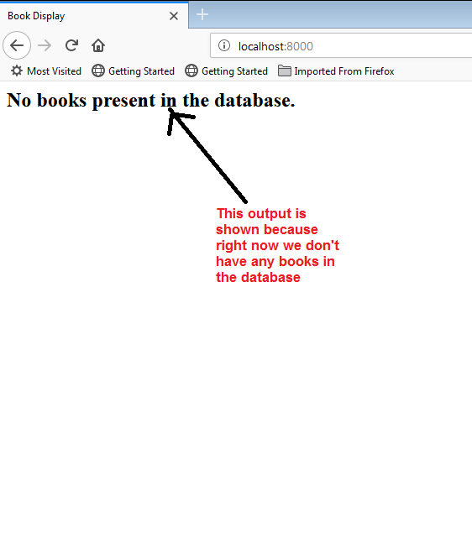
Running The App
Now start the server and open the page http://localhost:8000 and
this will load the page showallbooks.html with the following output:

Slide 31
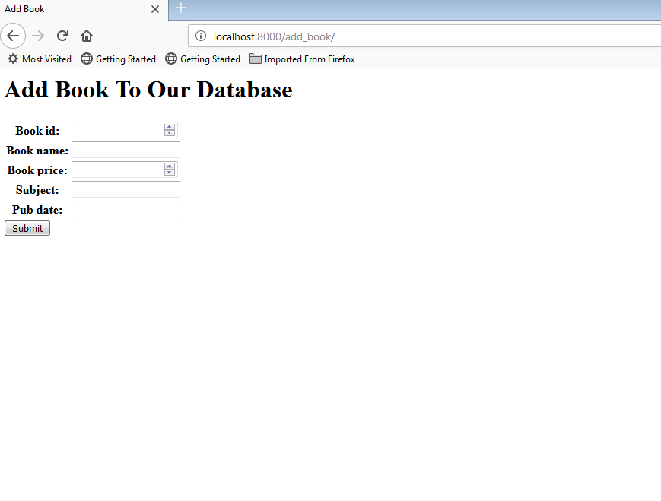
Running The App
Now open the page http://localhost:8000/add_book and
this will load the page addbook.html with the following output:

Slide 32
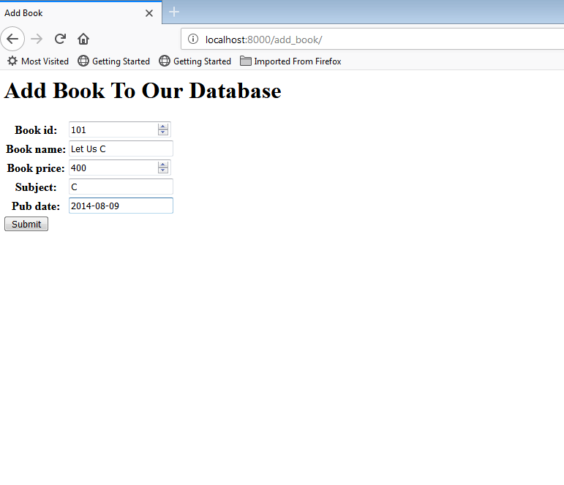
Running The App
Now fill up the book details and click on submit

Slide 33
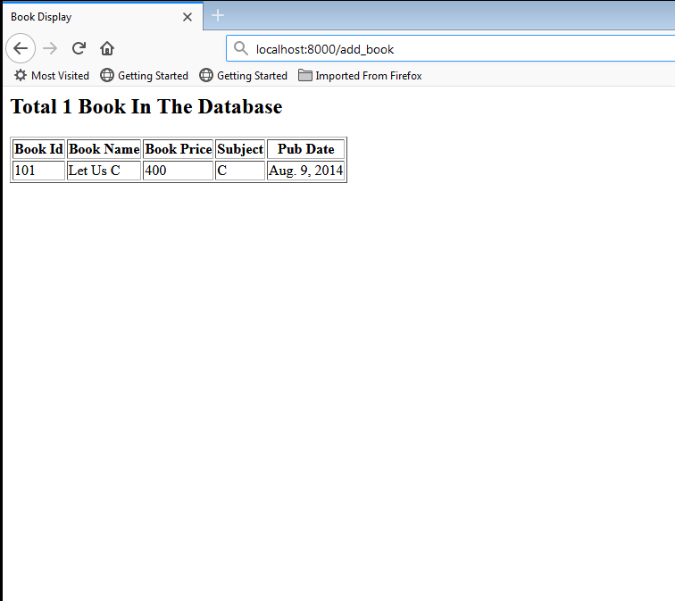
Running The App
This will show up the showallbooks.html page with the detail of the book
added

Slide 34
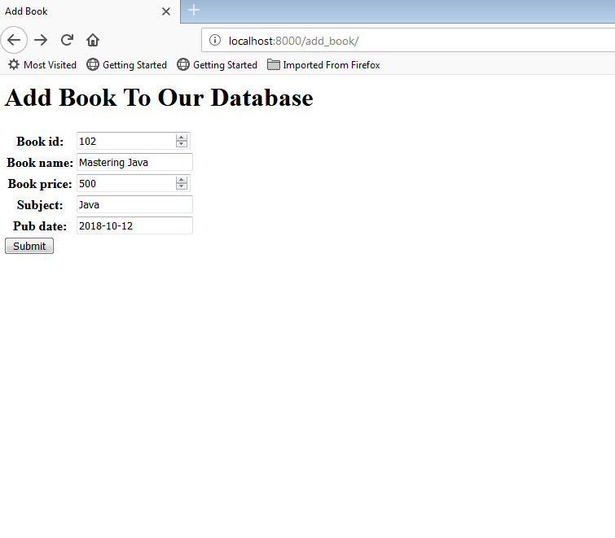
Running The App
Again go back to add_book and fill up another book details and click
on submit

Slide 35
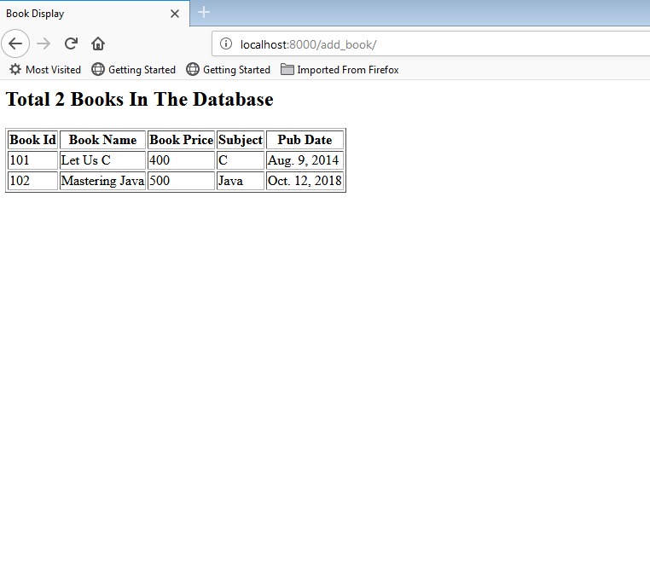
Running The App
This will show up the showallbooks.html page with the details of 2 books
added

